Slide 1
MHTECHIN
FRONT-END AND BACK-END TECHNOLOGY
By
V.Madhavi

Slide 2
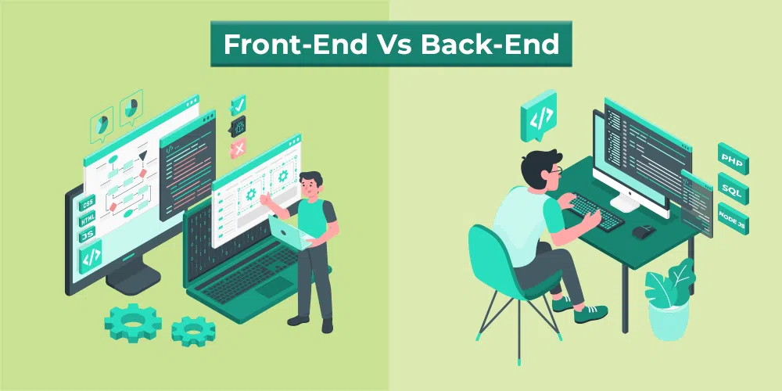
INTRODUCTION:
Web technologies refers to the way computers/devices communicate with each other using mark up languages.
Front End development and Back End development are responsible for the internet you interact with — all day, every day.
Front End development uses front-end programming languages to create what the user sees in a browser.
Back End development uses back-end programming languages to fulfill those requests on the server side.

Slide 3
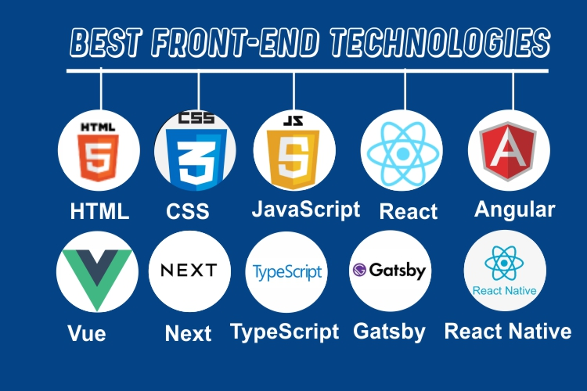
FRONT-END TECHNOLOGY:
Front-end developers use computer programming languages like :
HyperText Markup Language (HTML):HTML lays out the site's content and structure.
Cascading Style Sheets (CSS): adds design features.
JavaScript : creates advanced interactive features like like videos, audio, animations, and games.

Slide 4
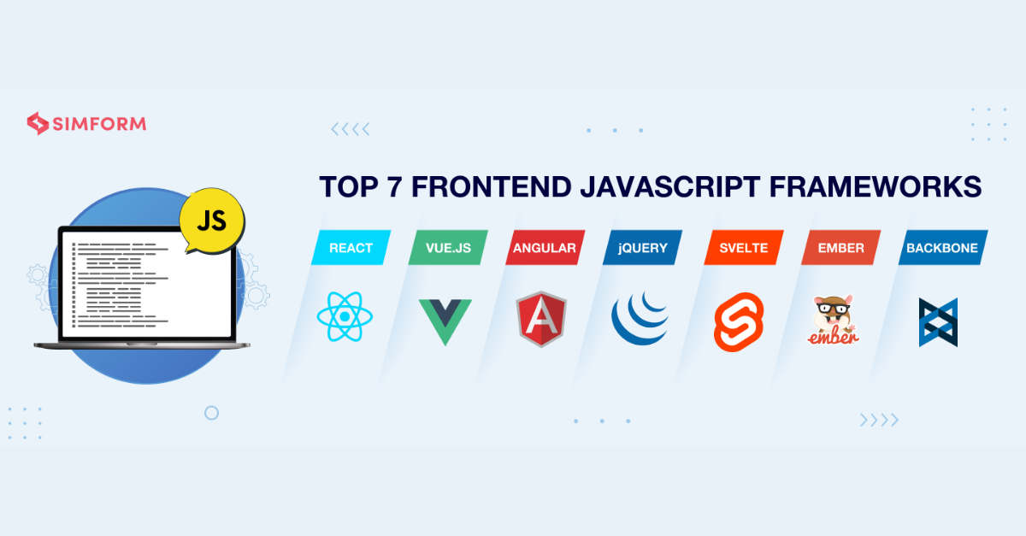
These developers use frameworks and libraries like :
AngularJS: It is a JavaScript open-source front-end framework that is mainly used to develop single-page web applications(SPAs).
React.js: React is a declarative, efficient, and flexible JavaScript library for building user interfaces.
jQuery: jQuery is an open-source JavaScript library that simplifies the interactions between an HTML/CSS document, or more precisely the Document Object Model (DOM), and JavaScript.
SASS: It is the most reliable, mature, and robust CSS extension language.
Flutter: Flutter is an open-source UI development SDK managed by google. It is powered by the Dart programming language.

Slide 5
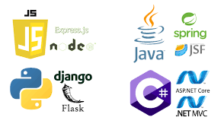
BACK-END TECHNOLOGY:
Back-end developers focus on the server side of websites.
Back-end developers in server-side programming languages like :
Python: programming language to write data structures and algorithms to create websites.
Java :Developers on the back end use this programming language, created for compatibility with other platforms, to build applications.
Ruby :is a free, open-source, back-end programming language.
PHP: PHP is a server-side scripting language designed specifically for web development.
Node.js : Node.js is an open-source and cross-platform runtime environment for executing JavaScript code outside a browser.

Slide 6
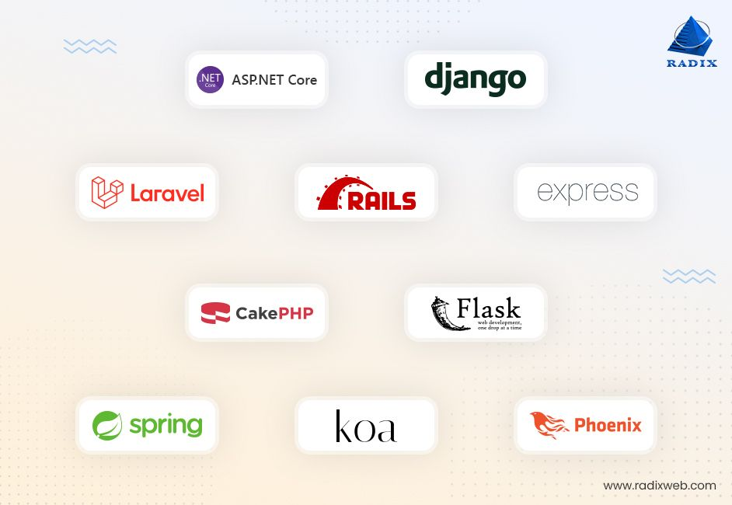
Back-End Frameworks:
Express – Express is a Nodejs framework used for backend/server-side development.
Django – Django is a Python web-based framework, following the model-template-views pattern.
Ruby on Rails – Ruby on Rails is a server-side framework following the model-view-controller architecture pattern.
Laravel – Laravel is a web application framework for PHP and is robust.
Spring – This server-side framework provides infrastructure support for Java applications.

Slide 7
DIFFERENCE BETWEEN FRONT-END AND BACK-END TECHNOLOGY:
BASIS | FRONT-END | BACK-END
DEFINITION | Front end development involves the effective implementation of visual components of a web application. | Back end development involves the effective implementation of functions of a web.
SKILLS REQUIRED | The skill set required for the front end includes HTML, CSS, SASS, JavaScript, etc. | The skill set required for the back end development includes Python, Ruby, Java, PHP, etc.
INDEPENDENCE | Front end development cannot work independently except in the case of static sites. | Back end development works independently of the front end as Back end

Slide 8
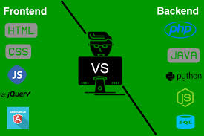
GOAL | The goal is to ensure that the application is accessible by everyone and it remains responsive on all the platforms such as desktop, talbot, and phone. | The goal of the back end development is to ensure that the application runs under all the provided cases, be scalable, and work efficiently with low latency without fail.
FRAMEWORKS USED | AngularJS, React, vue.js, etc. | Django, Flask, CakePHP, Laravel, Ruby on Rails, etc.

Slide 9
Conclusion:
Web development is an interesting branch in the field of technology.
Front end development is like the exterior of a house; The paint, the wall carvings, the wall hangings, or anything that a person can see and feel.
The back end is like the electric supply, the construction materials which one cannot see, but is crucial for the house. It is only together that these two things make an application look and function in the best way possible.

